Slide 1





SATYAM PRAKASH GUPTA

Slide 2

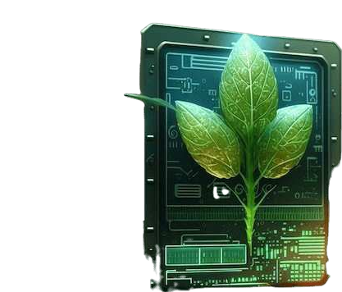
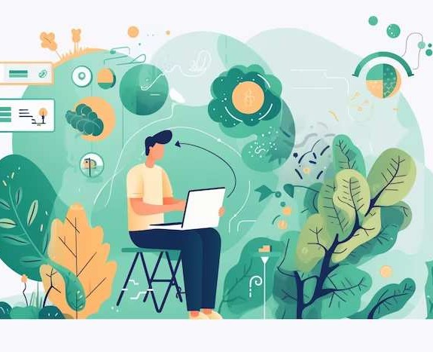
WATERING THE FUTURE: HARNESSING TECHNOLOGY FOR AUTOMATED PLANT CARE

Slide 3

WELCOME TO THE FUTURE
Innovative technology is revolutionizing automated plant care. Let's explore how we can utilize these advancements to create a sustainable and e cient future for plant cultivation.

Slide 4
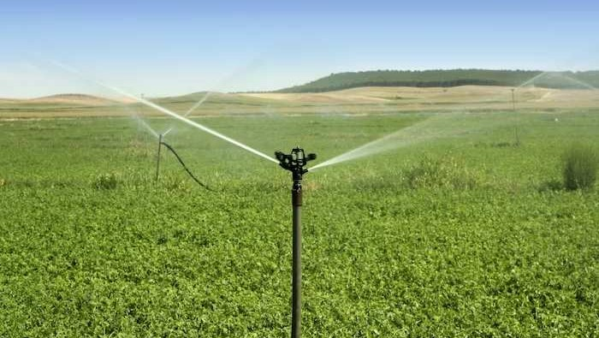
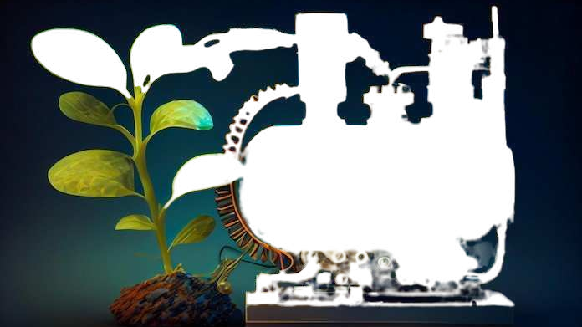
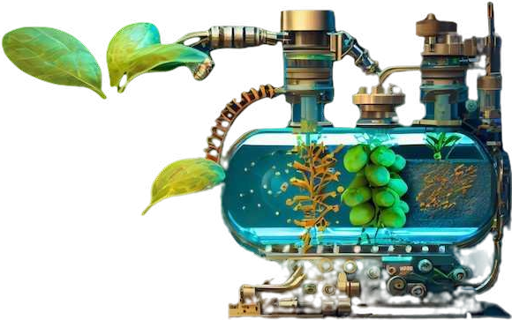
THE POWER OF AUTOMATION
Automated systems provide precise watering schedules and nutrient delivery, ensuring optimal plant health. This reduces manual labor and allows for remote monitoring and control.

Slide 5
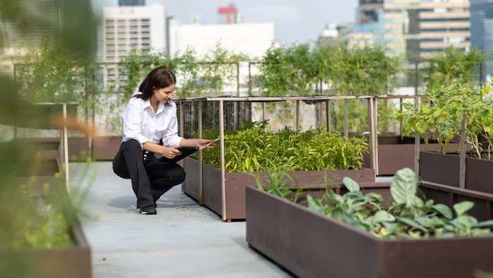
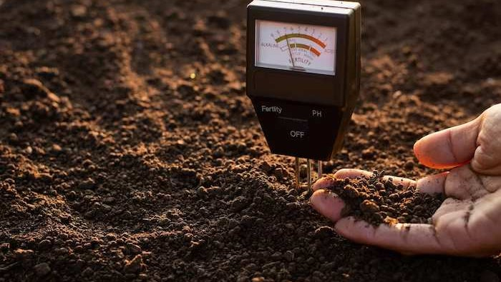
SENSING PLANT NEEDS
Sensors detect moisture levels, light intensity, and temperature, enabling personalized care for each plant. This data- driven approach enhances and plant growth.

Slide 6
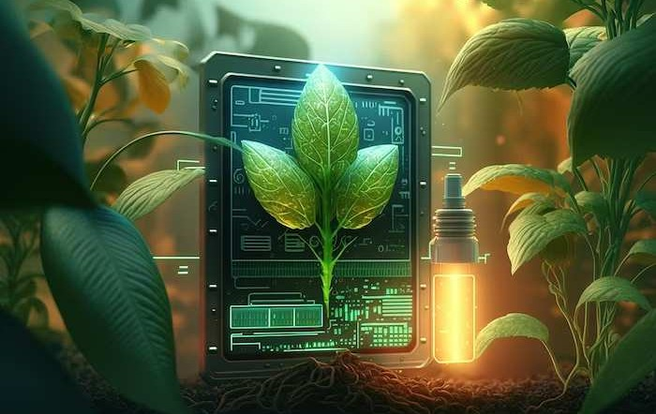
SMART PLANT HEALTH MONITORING
Delve into the world of plant,
Health monitoring where advanced technology detects early signs of stress or disease, allowing for proactive intervention.

Slide 7
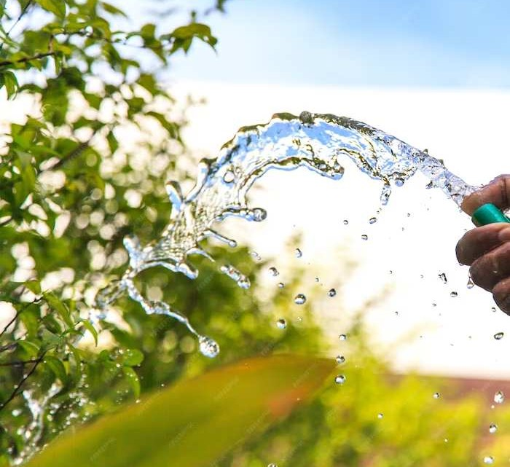
SMART IRRIGATION SOLUTIONS
Smart irrigation systems utilize real-time data to deliver precise amounts of water, conserving resources and preventing overwatering. This promotes sustainability and environmental stewardship.

Slide 8
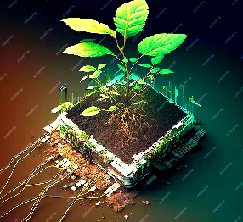
INTELLIGENT NUTRIENT DELIVERY
Automated nutrient delivery systems dispense the exact amount of fertilizers and supplements, ensuring plants receive the necessary nutrients for optimal growth.

Slide 9
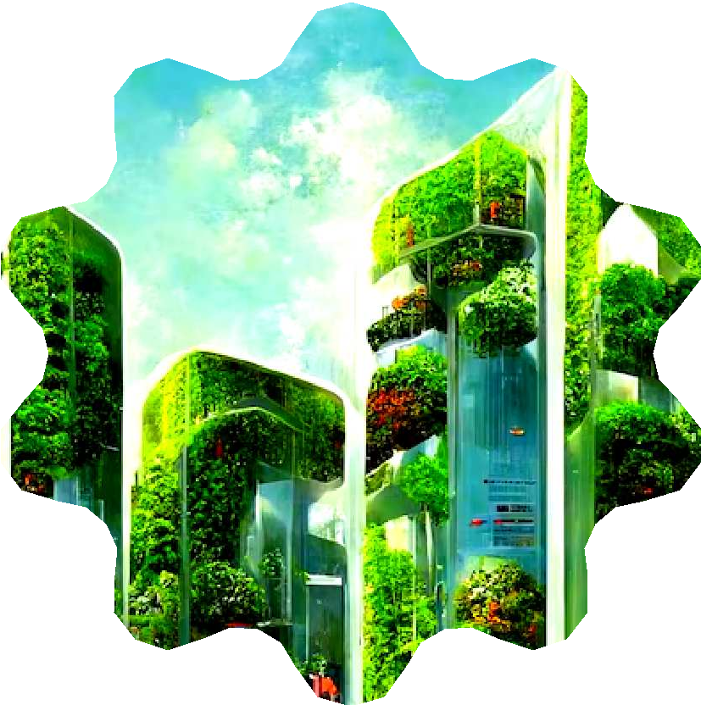
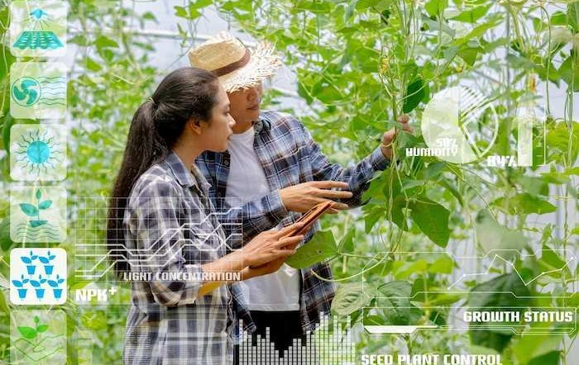
FUTURE POSSIBILITIES
Advancements in technology continue to expand the possibilities for automated plant care, from vertical farming to urban gardening. The future holds limitless potential for sustainable and ancient plant cultivation.

Slide 10


EMBRACING SUSTAINABLE INNOVATION
By harnessing technology for automated plant care, we can create a greener and more sustainable future.
Let's work together to nurture our
environment and ensure a ﬂourishing tomorrow.

Slide 11
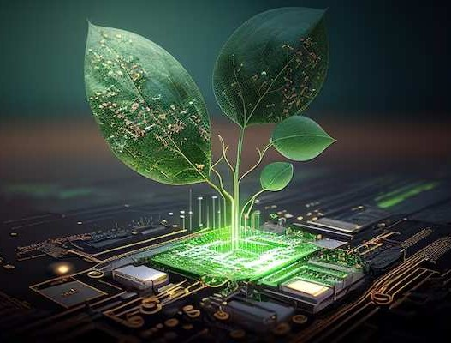
THE FUTURE OF GREEN INNOVATION
Envision the future of green evolution through the lens of technology, where sustainable and encient plant care practices drive environmental progress.

Slide 12
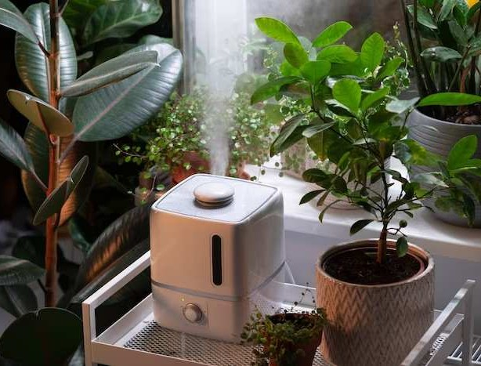
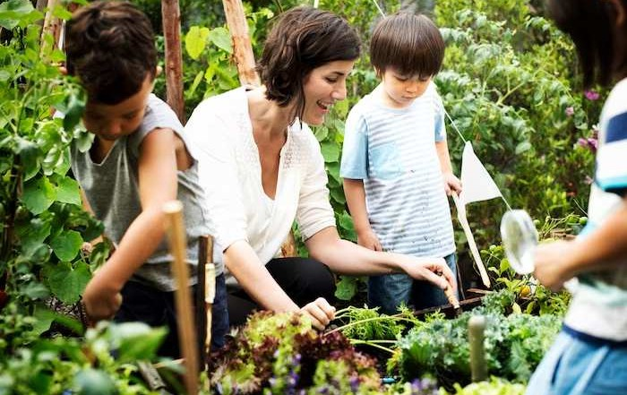
EMPOWERING HOME GARDENERS
Empower home gardeners with
technology that simplifies plant care, making it accessible and enjoyable for individuals of all skill levels.

Slide 13
CONCLUSION: CULTIVATING THE FUTURE
The fusion of technology and plant care opens new horizons for sustainable cultivation. Let's continue to innovate and embrace the potential of automated systems to create a thriving and eco- conscious future.

